Slide 1
best_path_forward_gbf
Pipeline: Best Path Foward
Vessel Pathway: Common
Port Pathway: Common

Slide 2
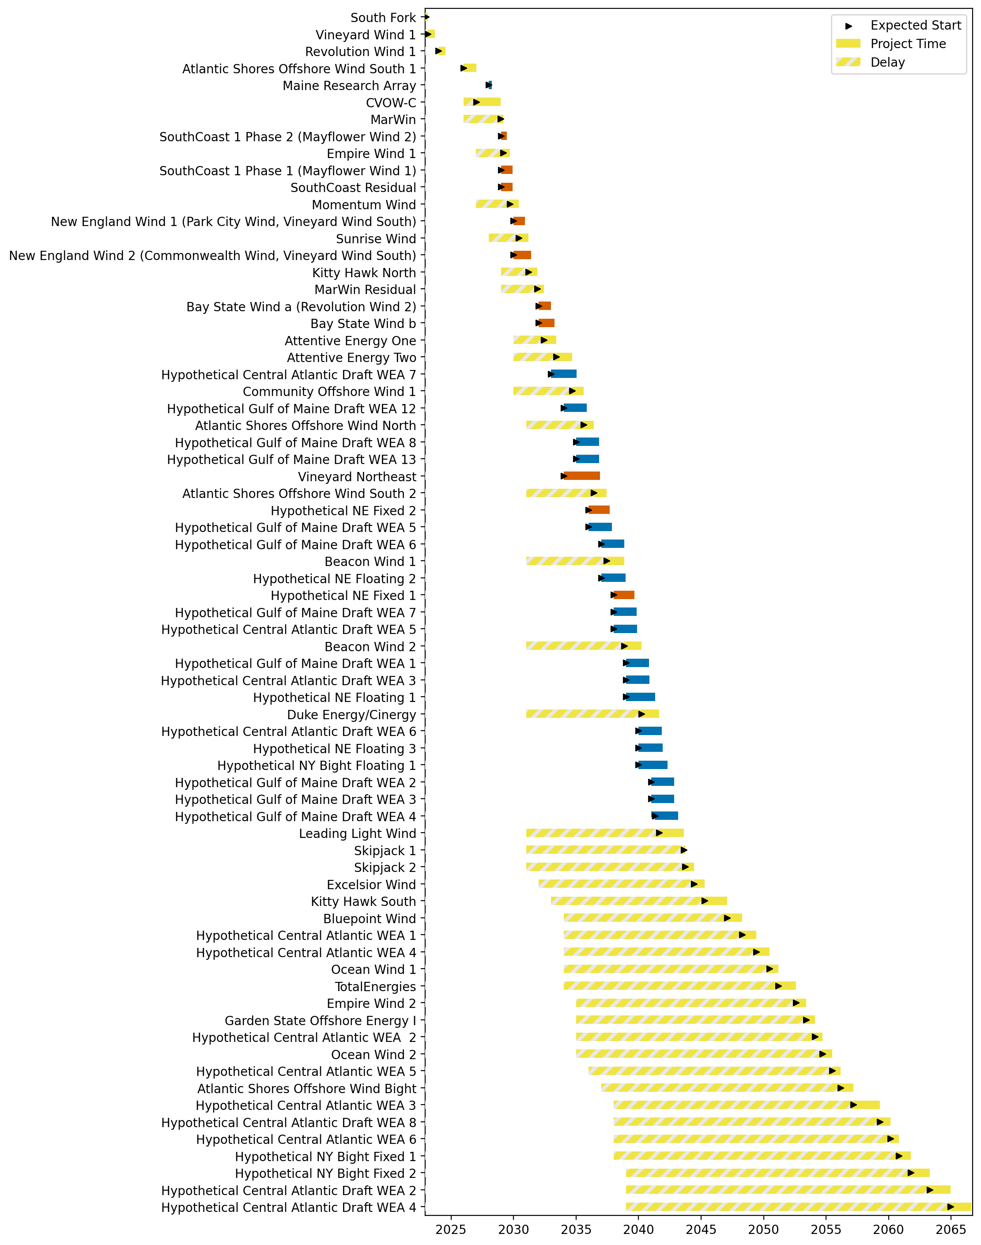
Full Gantt

Slide 3
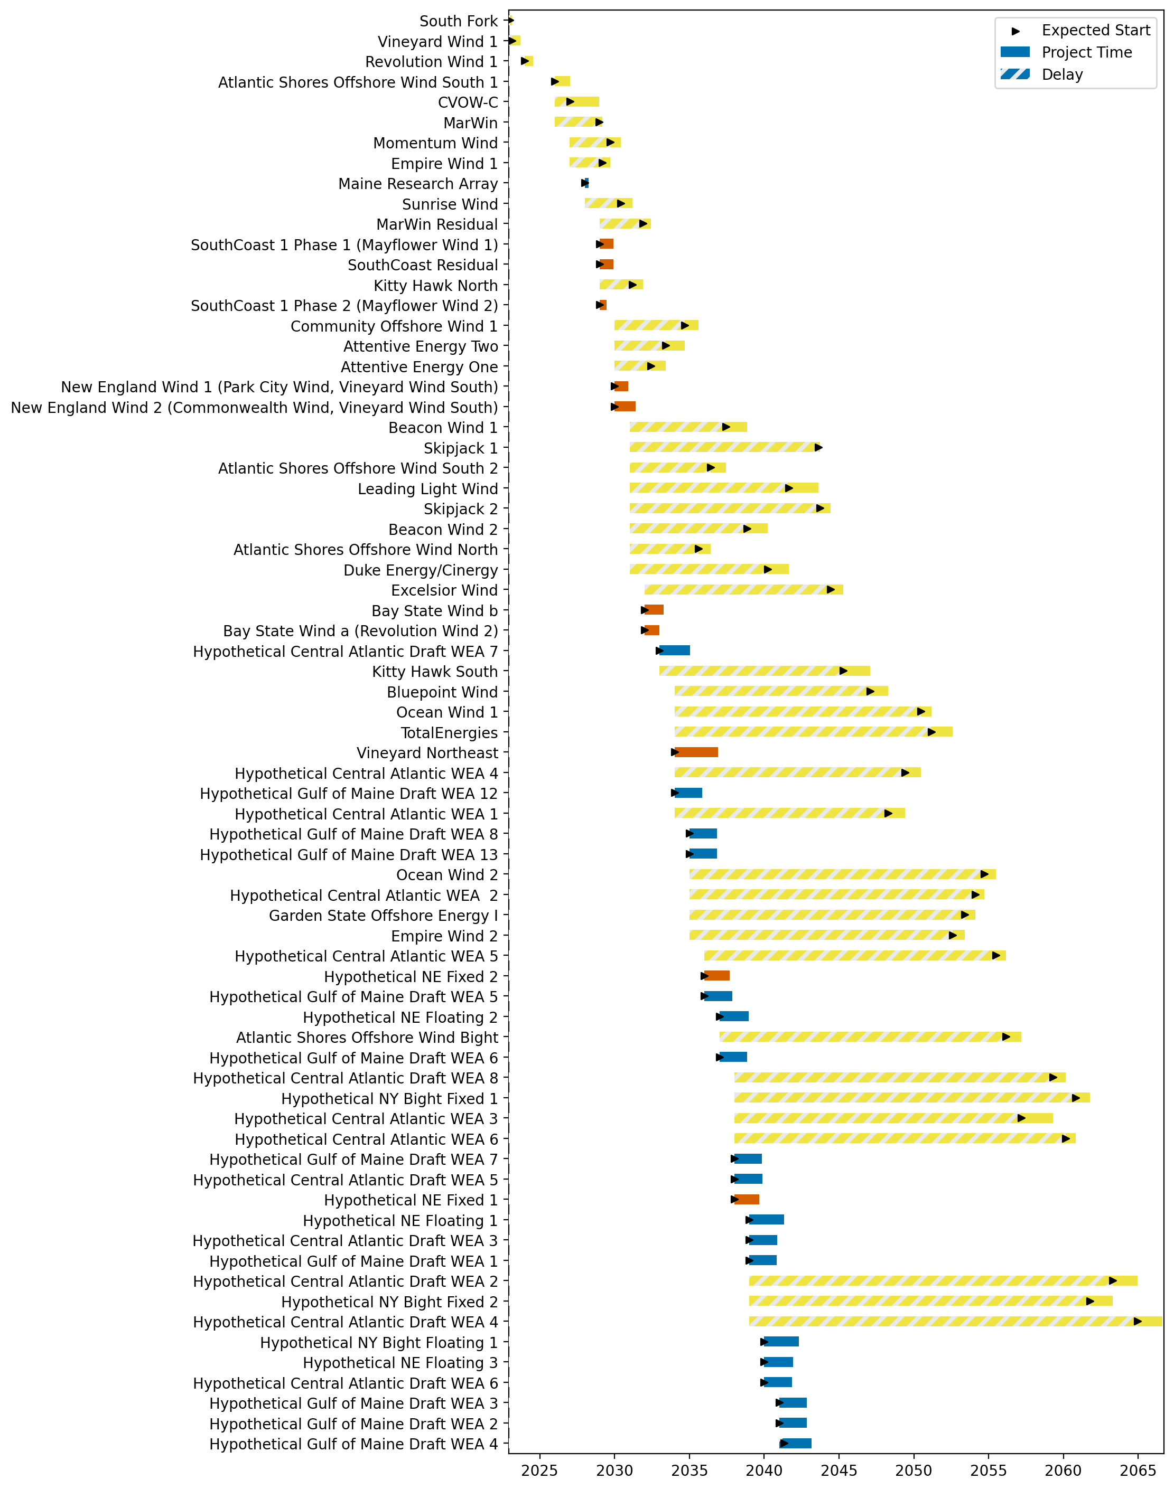
Sorted Full Gantt

Slide 4
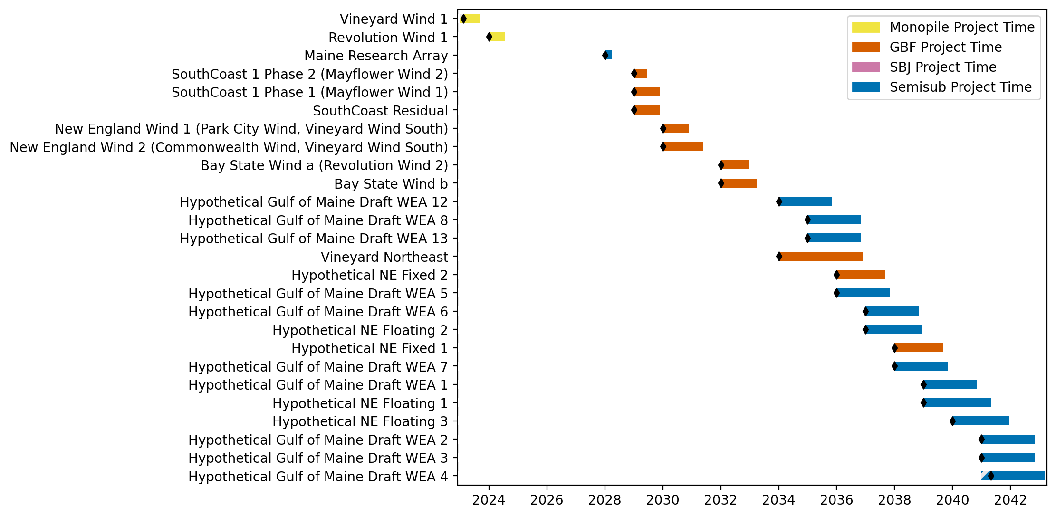
New England Gantt

Slide 5
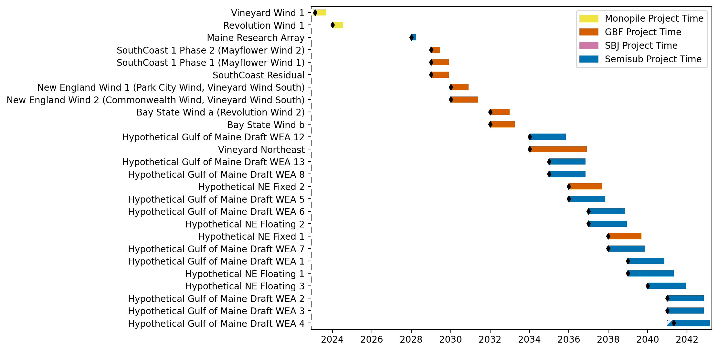
Sorted New England Gantt

Slide 6
best_path_forward
Pipeline: Best Path Foward
Vessel Pathway: Common
Port Pathway: Common

Slide 7
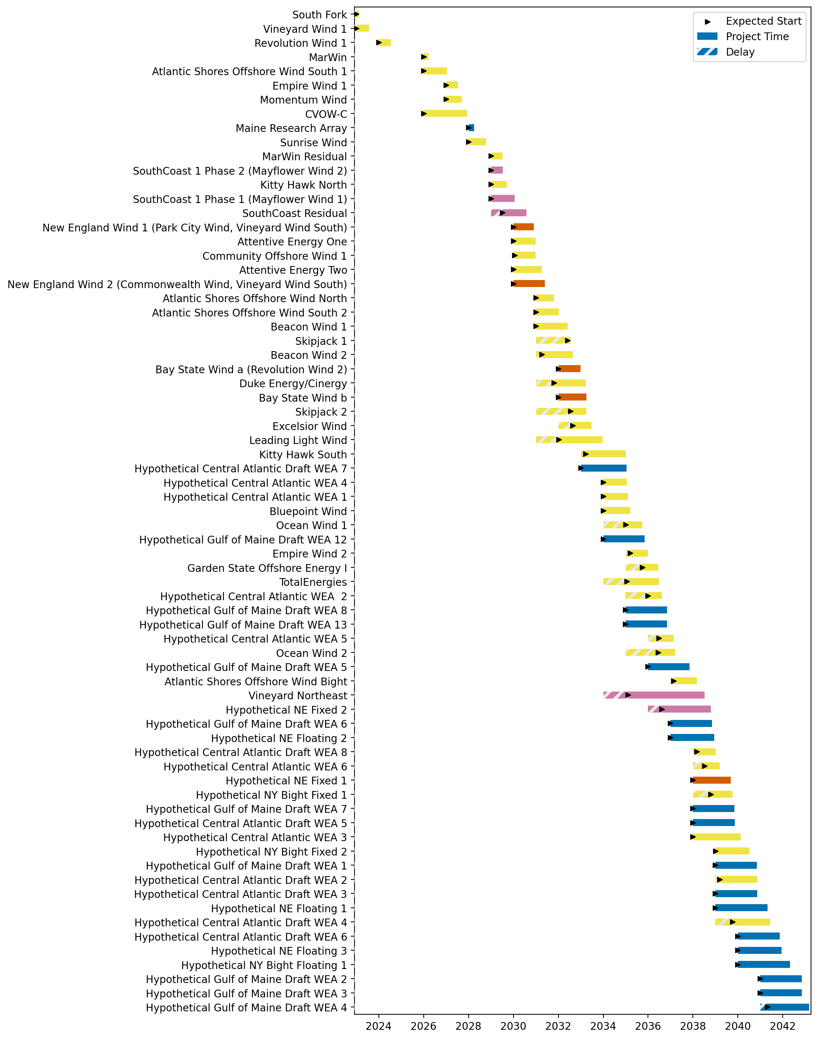
Full Gantt

Slide 8
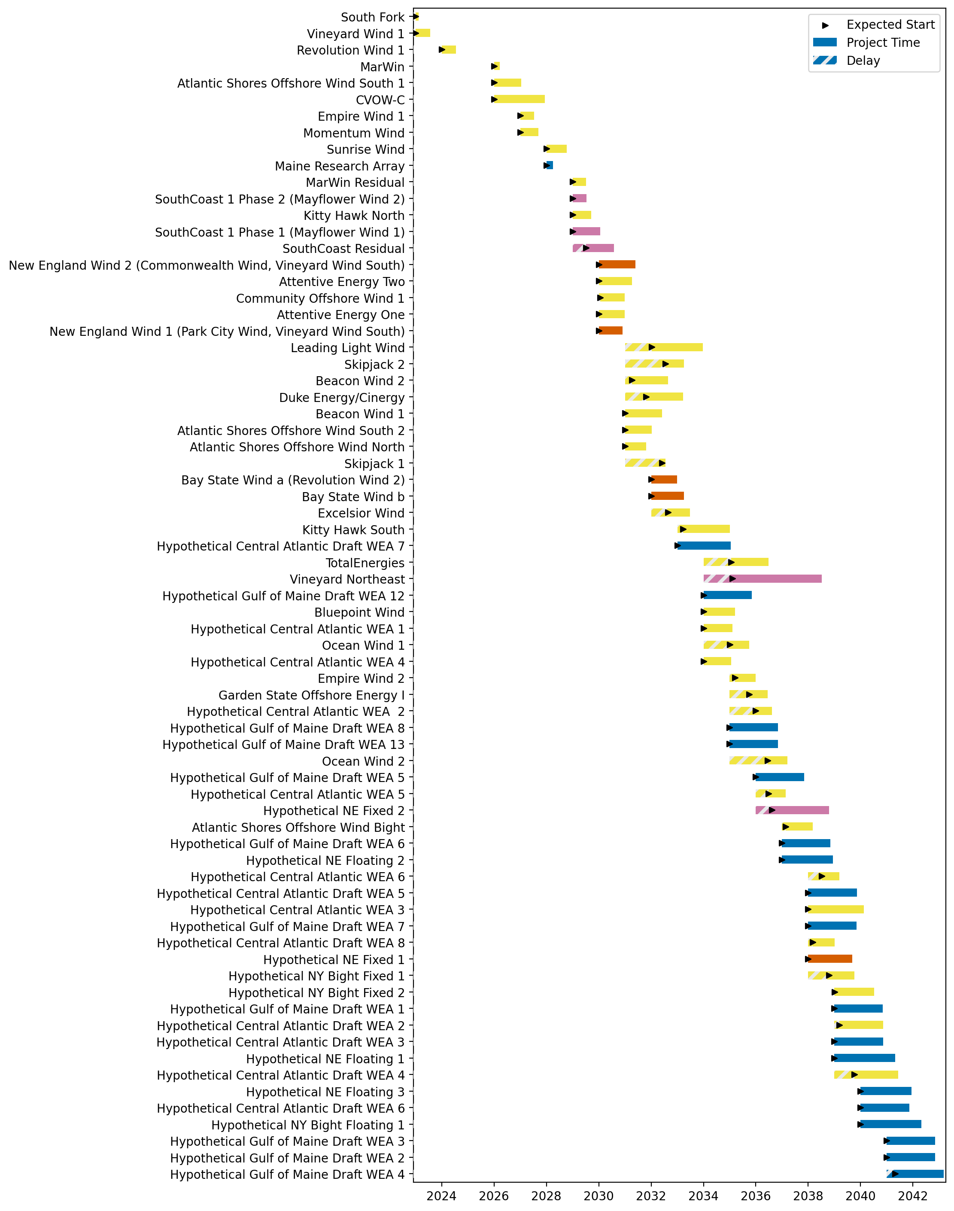
Sorted Full Gantt

Slide 9
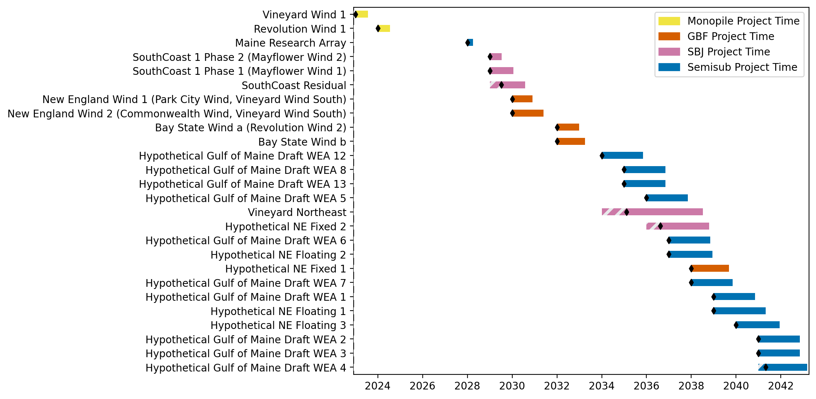
New England Gantt

Slide 10
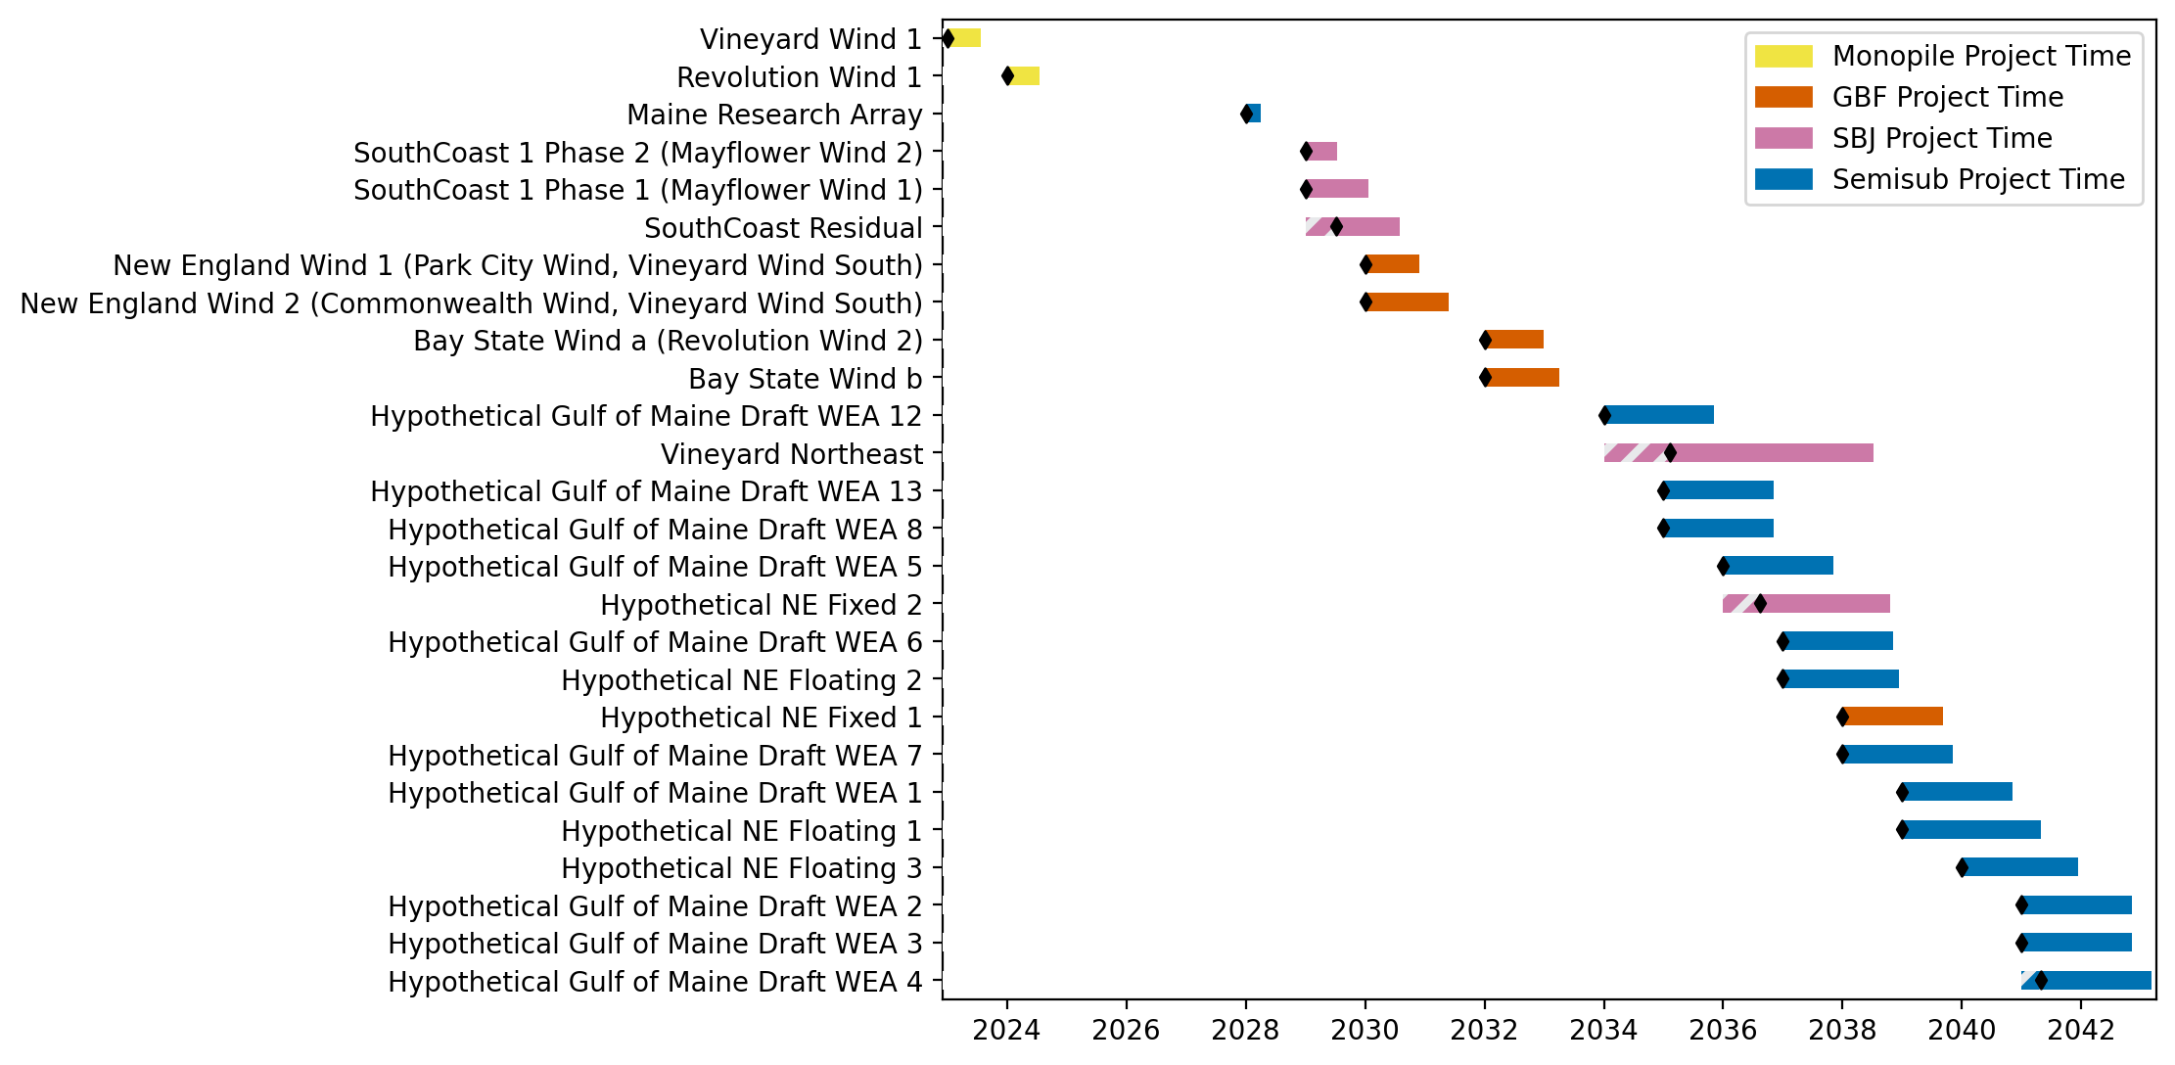
Sorted New England Gantt

Slide 11
full_monopile
Pipeline: Full Monopile Pipeline
Vessel Pathway: Common
Port Pathway: Common

Slide 12
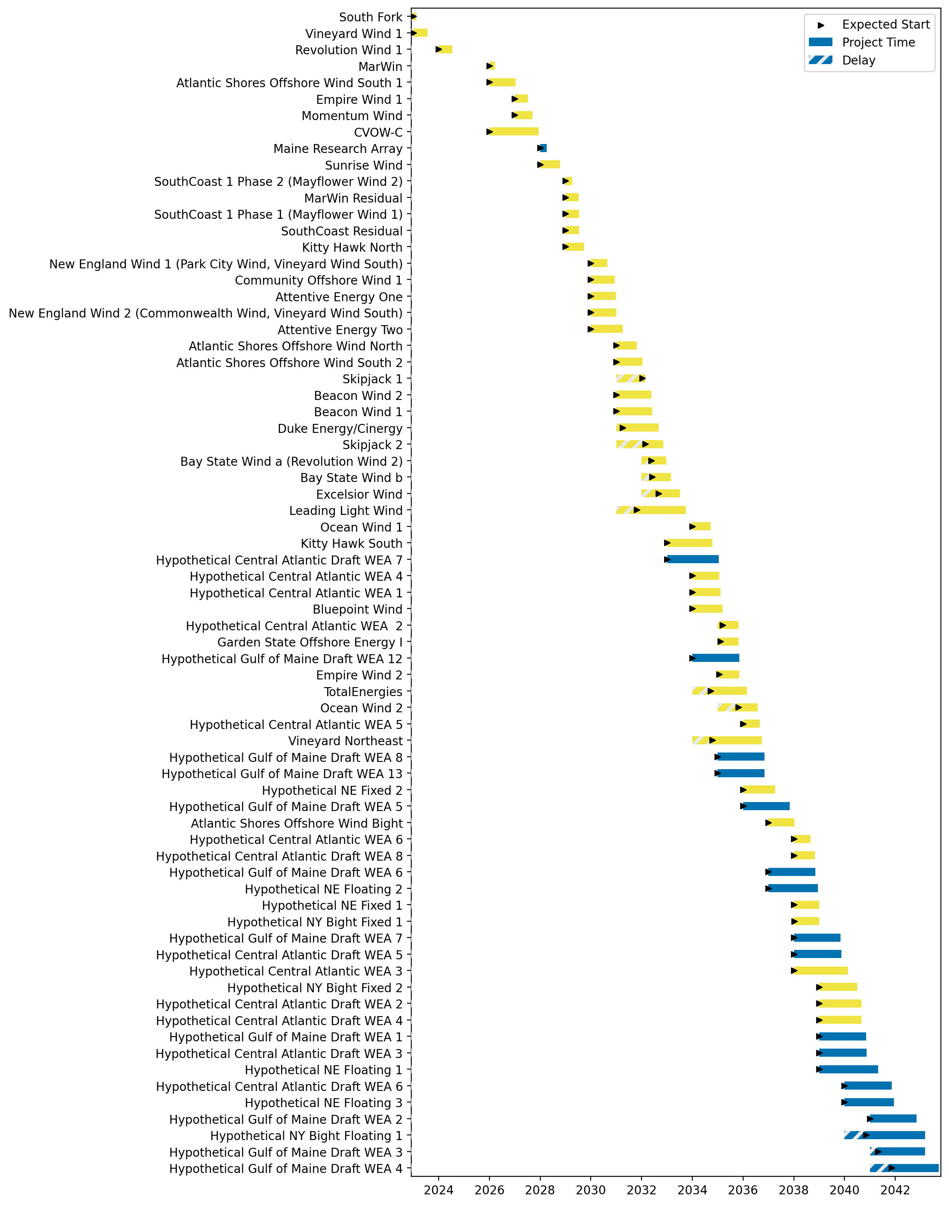
Full Gantt

Slide 13
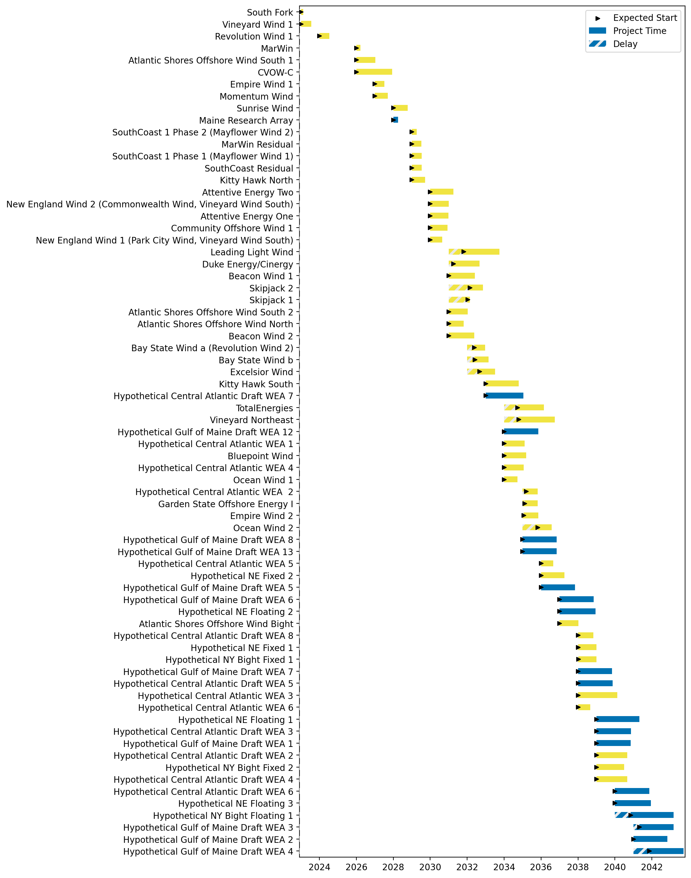
Sorted Full Gantt

Slide 14
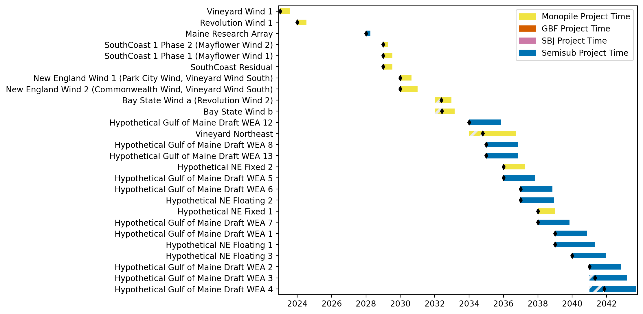
New England Gantt

Slide 15

Sorted New England Gantt

Slide 16
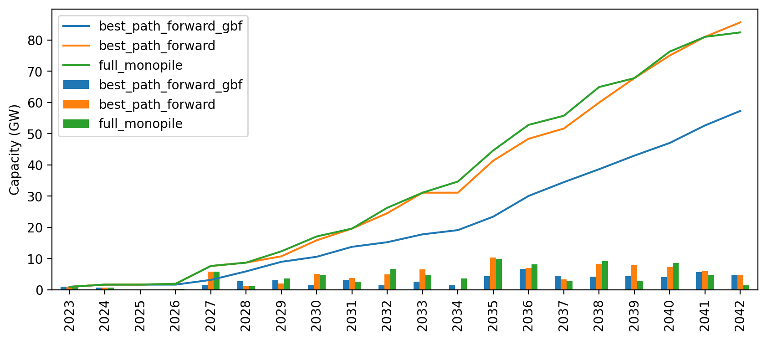
Cumulative Installed Capacity

